Slide 1

Chapter 3 – Group membership
Member needs, member roles and what else?

Slide 2
3.1 Member needs
3.2 Member roles
3.3 Member confidence
3.4 Member assertiveness

Slide 3
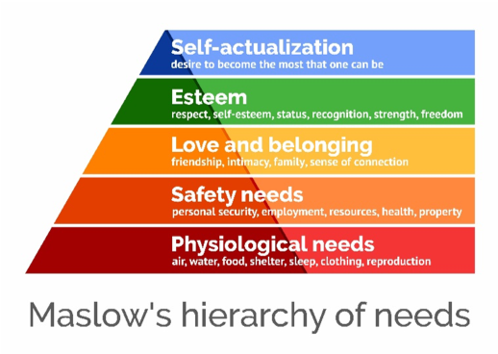

Slide 4


Mark Zuckerberg left Harvard Bình Tân left Harvard

Slide 5
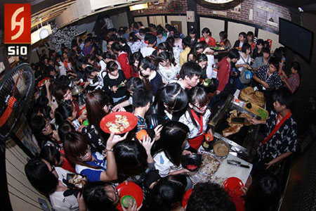
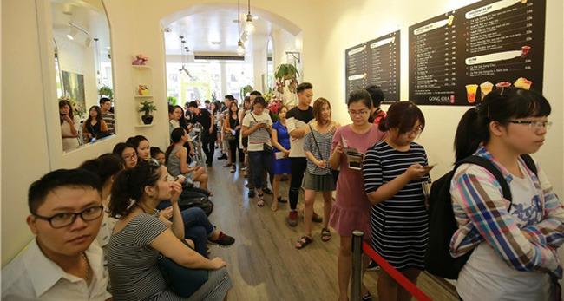
Where are they in Maslow’s hierarchy of needs?

Slide 6
Which needs did he have?
Once upon a time, there was an officer who worked really well. His profile was very clean , never received gifts from people.
When he retired, a person who he helped before came to see his wife “what zodiac animal of your hubby?” – “mouse”
The guy gave the wife a gold mouse
The officer came home and slapped the wife , “ why did not u say I was born in the year of a buffalo??????”

Slide 7
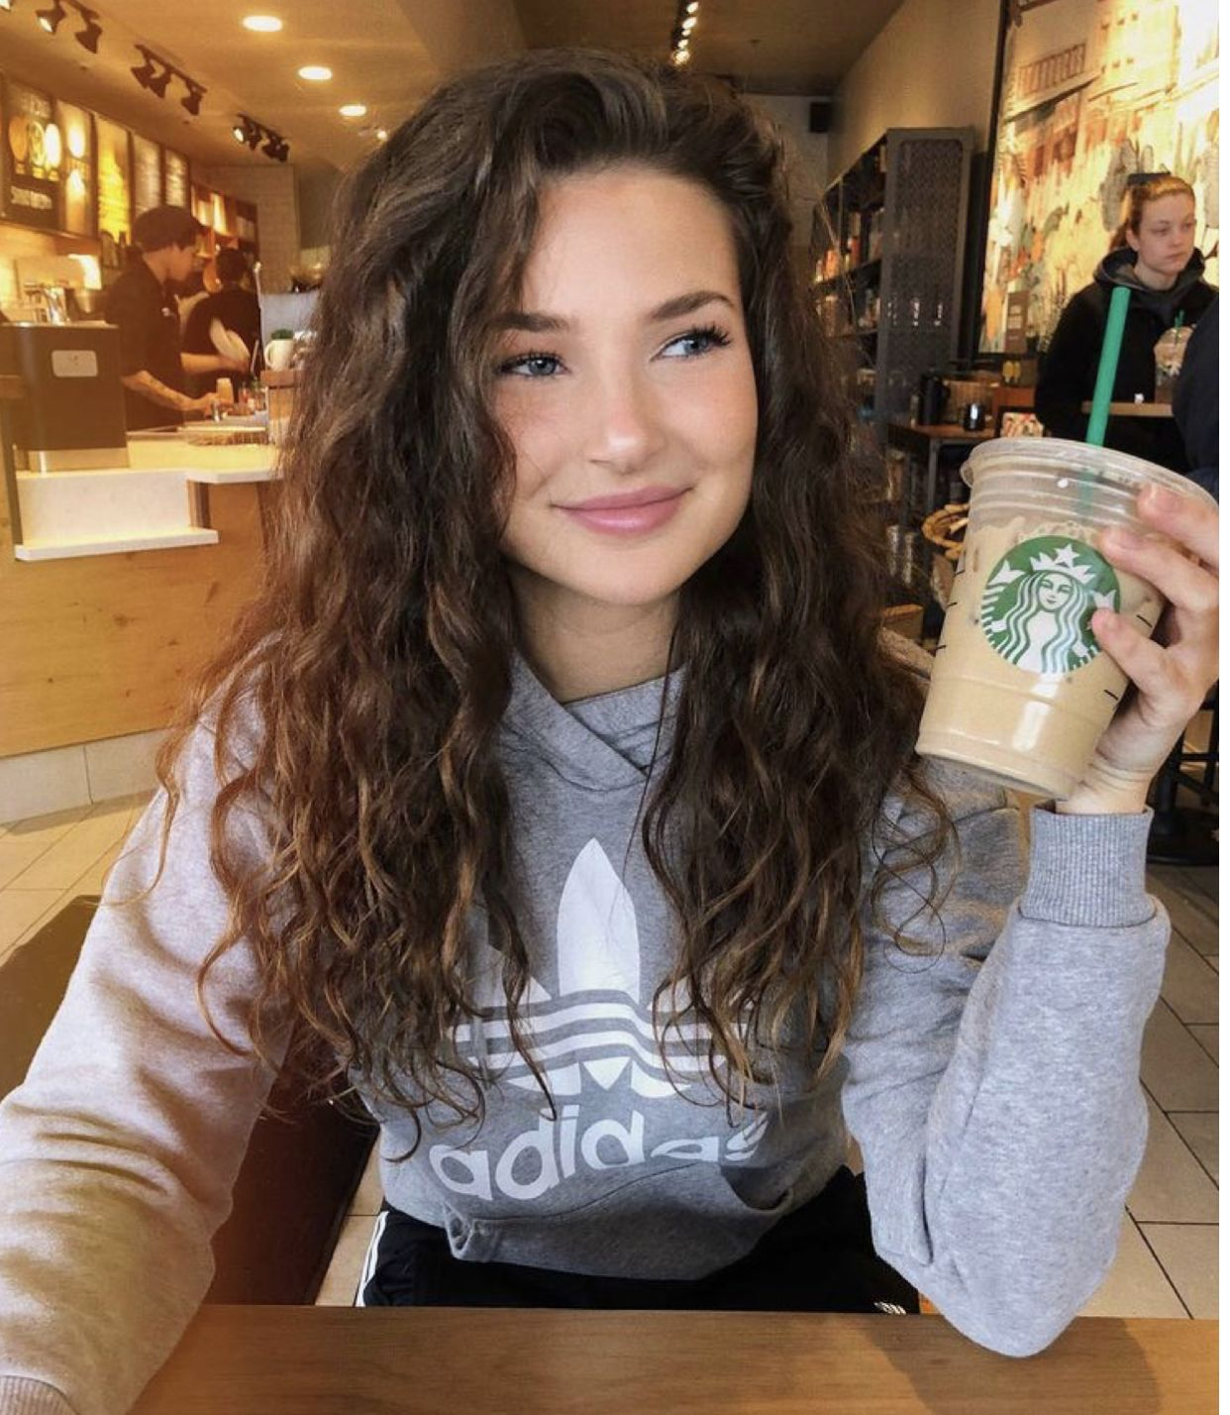
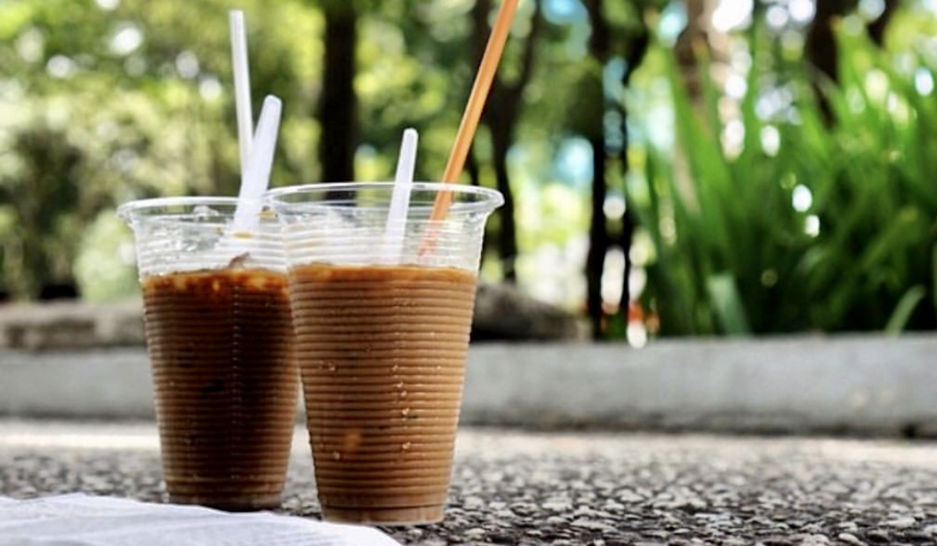
Café shop

Slide 8
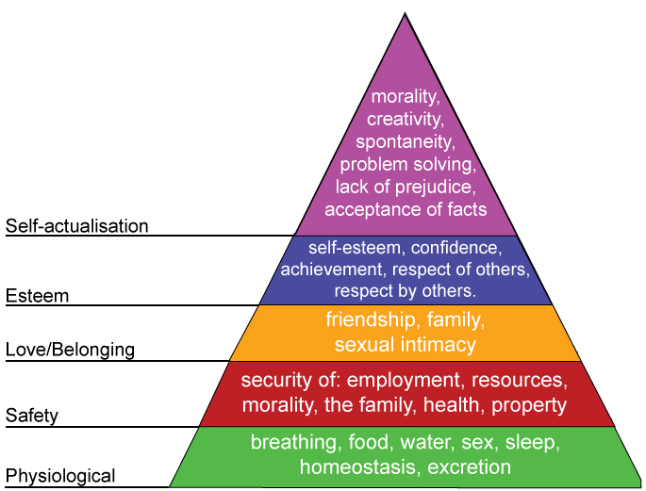
Maslow’s Hierarchy of Needs

Slide 9
Match the Need to the Group
Need
Physiological
Safety
Belongingness
Esteem
Self-Actualization
Group
___ police force
___ family
___ garden society
___ adult literacy group
___ sorority/fraternity
___ executive club
___ pro basketball team

Slide 10


Slide 11
Schutz’s Theory of Interpersonal Needs p.54
Fundamental Interpersonal
Relationship Orientation (FIRO)
Need for INCLUSION
Need for CONTROL
Need for AFFECTION

Slide 12

Schutz’s Theory of Interpersonal Needs p.54
Need for INCLUSION
Need for CONTROL
Need for AFFECTION

Slide 13
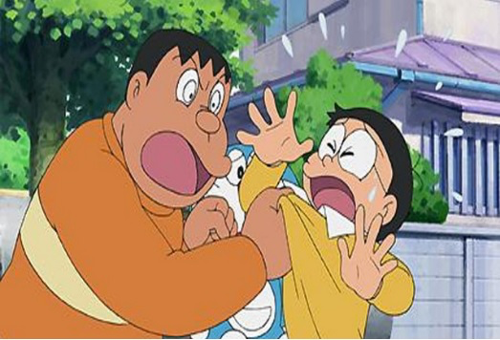
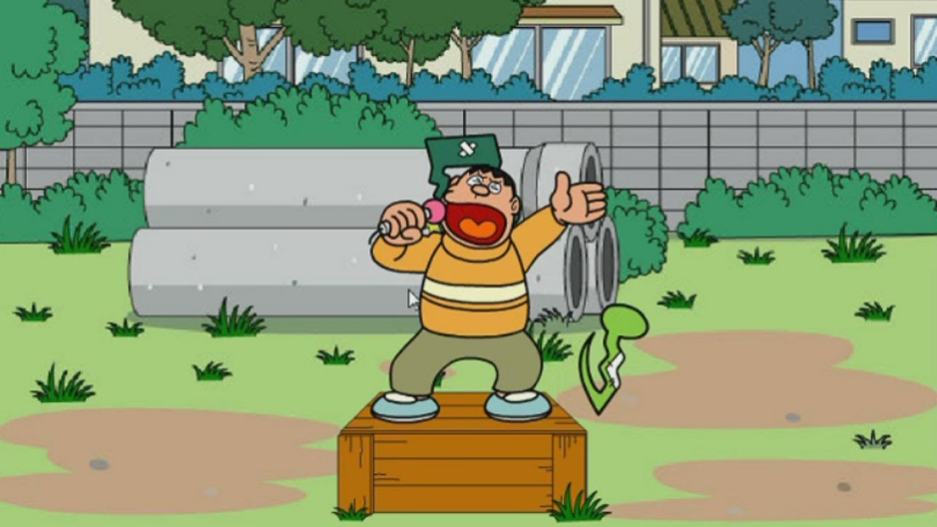
What are Chaien’s interpersonal needs?
Need for INCLUSION
Need for CONTROL
Need for AFFECTION

Slide 14
Inclusion Needs
“I need to feel accepted by the group.”
“I feel accepted by the group.”
“I don’t feel accepted by or involved in the group.”
“I won’t participate much in group discussions.”
“I try to gain the group’s attention.”
Social Member
Undersocial Member
Oversocial Member

Slide 15
Control Needs
“I need to feel influential and important.”
“Others respect me.”
“I don’t have influence in the group.”
Democratic Member
“I just do what I am told.”
“I try to dominate the group.”
Abdicrat
Autocrat

Slide 16
Affection Needs
“I need to feel that others like me.”
“I feel that others like me and if they don’t, that’s OK.”
“I’m not sure that others like me.”
“I avoid friendships with other members.”
“I confide in and try to become very close with others.”
Personal Member
Underpersonal Member
Overpersonal Member

Slide 17
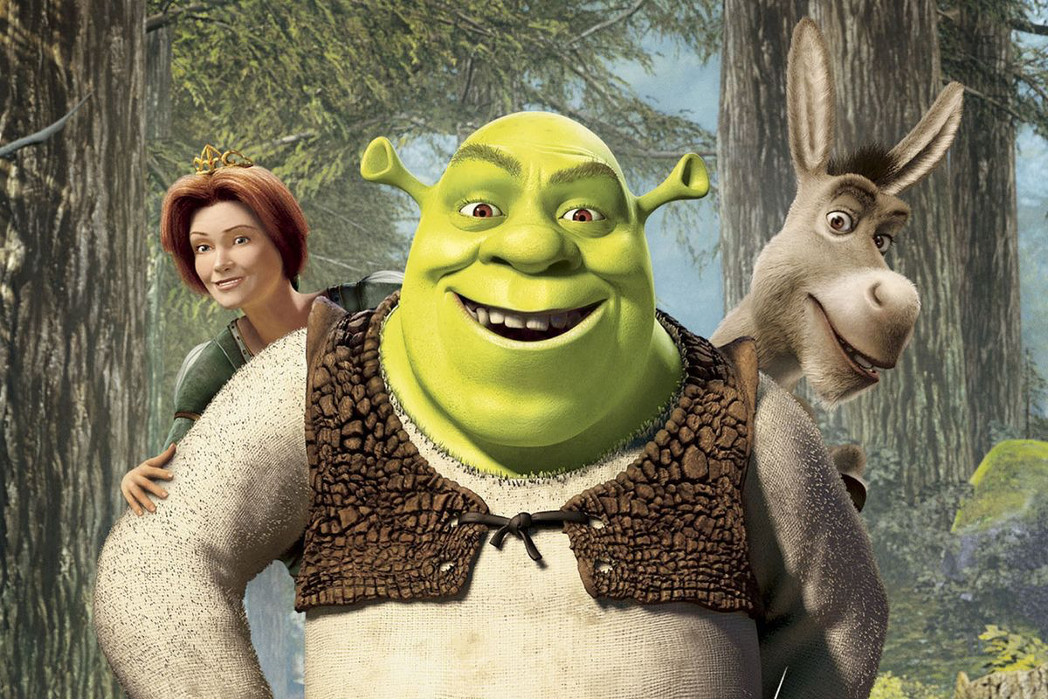
What are their interpersonal needs?
Need for INCLUSION
Need for CONTROL
Need for AFFECTION

Slide 18
In group – choose ONE- 30’
Discuss the interpersonal needs (according to Schutz) of the characters in the movie. Post on LMS a picture of your chosen movie and explain the characters’ needs in 100 words.
Discuss TWO people who have the same actions with different needs according to Maslow’s hierarchy of needs. Post on LMS picture of the chosen products and your discussion in 100 words.

Slide 19
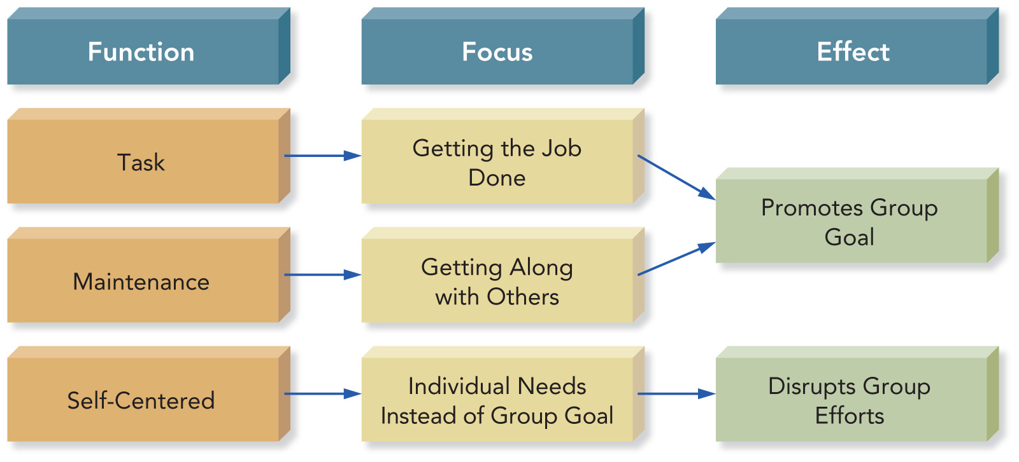
Group Role Categories

Slide 20
Group Task Roles
Initiator
Information Seeker
Coordinator-Chairperson
Information Giver
Opinion Seeker
Opinion Giver
Clarifier-Summarizer
Implementer-Completer
9. Evaluator-Critic
10. Energizer
11. Procedural Technician
12.Recorder-Secretary

Slide 21
Group Maintenance Roles
Encourager-Supporter
Harmonizer
Compromiser
Tension Releaser
Gatekeeper
Observer-Interpreter
Teamworker-Follower

Slide 22
Interpreter
I don’t like your presentation => your presentation is good but it could be better if you improve pronunciation or adjust some…/ u should explain more/ may consider/ how about more … A B
Why don’t you say anything? => how do u thik about this ABCD? do u have anything to say? Do u want add sth? I really want to hear your opinions / feel free to express more / I think your idea will be great/
Why do you sleep in my class?=> u feel tired? U need to wash your face? Is my teaching boring? U should sleep early! I feel so toang! How many slots left? This will be in the final exam.
Don’t be lazy.=>
You are late again, huh?=>
Turn down a romantic confession=>

Slide 23
Identify Bình ’s Role(s)-p.57/58
___ Compromiser: offer solution/ suggestions
___ Gatekeeper: make sure everyone work
__ Harmonizer
___ Interpreter
___ Evaluator
___ Clarifier-Summarizer
___ Energizer
___ Opinion Giver
___ Recognition Seeker
___ Follower
Bình expresses his personal opinions and feelings.
Bình summarizes group progress and draws conclusions.
When Thành&Lộc&Phát&Hải argue, Bình mediates conflict and paraphrases what others say.

Slide 24
Interpreter
What you say is stupid.=> Please give more reasons to support your opinion.
How can you get super low mark? => You should study harder then. => Try better next time! => What can WE do to get high mark next time?
Why you come late everyday? Do u have any problem going to work? => Be on time.= Be on time before 7am.
You are Lazy!!!=> please get to work => Please submit your assignment before 5pm today.
You are so round. => exercise/ reduce sugar…./ gym/....
We do not want you in this team.=> You out, you are fired, you are done => You are good for other team, not my team => We have enough people now. => Your ability is not suitable in this project. We will inform u next project

Slide 25
Identify Roland’s Role(s) p.57/58
___ Compromiser: offer solution/ suggestions
___ Gatekeeper: monitor participation = make sure everyone work
__ Harmonizer
___ Observer-Interpreter
___ Evaluator
___ Clarifier-Summarizer
___ Energizer
___ Opinion Giver
___ Recognition Seeker
___ Follower
Roland expresses his personal opinions and feelings. He summarizes group progress and draws conclusions. When group members argue, he mediates conflict and paraphrases what others say.

Slide 26
Quiz
“Phu yên, we has not heard from you yet and want to make sure that everyone gets a chance to speak up” Bình Định said, what is Bình Định’s role?
a. Harmonizer
b. Standard monitor
c. Observer-interpreter
d. Gatekeeper
e. Procedural technician

Slide 27
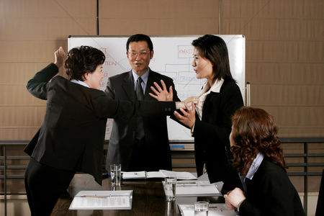
What are their roles?
B
C
A
D

Slide 28
What are their roles?
Opinion giver
B HARMONIZER
Opinion giver
C
A
Observer
D

Slide 29
Self-Centered Roles
Aggressor
Blocker
Dominator
Recognition Seeker
Clown
Deserter
Confessor
Special Interest Pleader

Slide 30


Slide 31
Group and Member Confidence
Members who lack confidence are less likely to share what they know or voice their opinions.
Confident members are more effective group members.
Confident groups are more likely to succeed.

Slide 32
Communication Apprehension
“An individual’s level of fear or anxiety associated with either real or anticipated communication with another person or persons.”
About 20 percent of the general population experiences very high levels of communication apprehension.
Virginia P. Richmond and James C. McCroskey,
Communication: Apprehension, Avoidance, and Effectiveness

Slide 33
How Confident Are You?
Are you comfortable participating in group discussions?
Do you like to get involved in group discussions? Are you afraid to express yourself at meetings?
Are you relaxed when answering questions at a meeting?

Slide 34
High Apprehensive
Avoid participation
Talk less often
Agree with others
Smile or giggle inappropriately
Fidget
Use awkward fillers phrases, e.g. “uh”
Have difficulty following a discussion

Slide 35
Low Apprehensives
Initiate discussion
Speak more often
Assert themselves
Are more likely to become leaders
Choose when to speak or be silent
Appear confident
May dominate discussion

Slide 36
Strategies for Coping with Communication Apprehension
Strategy: Know that you are not alone.
Strategy: ________________________.
Strategy: ________________________.
Strategy: Learn communication skills.
Strategy: ________________________.
Strategy: ________________________.
Strategy: ________________________.

Slide 37
Constructive Feedback
Guidelines for providing constructive feedback to enhance member confidence:
• Focus on the behavior, not the person.
• Describe rather than judge behavior.
• Provide observations rather than opinions.
• Choose an appropriate time and place for feedback rather than ignoring the situation.
• Give feedback to help others rather than to meet your own needs.

Slide 38
If you are a low apprehensive . . .
Supportive highly apprehensive group members by:
providing constructive feedback.
_______________________________.
_______________________________.

Slide 39
Confidence in Virtual Groups
Why are some people more confident communicating in virtual groups?
____________________________________.
They may not have to reveal information about their appearance, gender, race, status, etc.
Other members may overestimate a person’s qualities and abilities.
____________________________________.
____________________________________.

Slide 40
Assertiveness
Speaking up and acting in your own best interests without denying the rights and interests of others

Slide 41
Assertive Group Members
Appear confident, honest, open, and cooperative
Volunteer ideas and opinions
Ask and answer questions without fear or hostility
Stand up for their beliefs, even when others disagree
Express their feelings openly
Respect and defend the rights and opinions of others

Slide 42
Balancing Passivity and Aggression
Passive group members often lack confidence.
Reluctant to express their opinions and feelings, fear criticism, and usually do what they are told
Aggressive members act in their own self-interest at the expense of others.
Critical, insensitive, combative, and even abusive

Slide 43
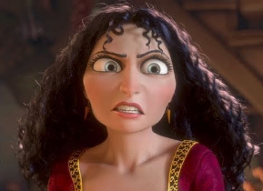
Passive-Aggressive Members
Passive-aggressive members mask aggression by appearing passive or cooperative.
They rarely exhibit aggressive behavior.
They do not respect the rights of others.
They often get what they want by
undermining others behind their backs.
deceiving others about their intentions.

Slide 44
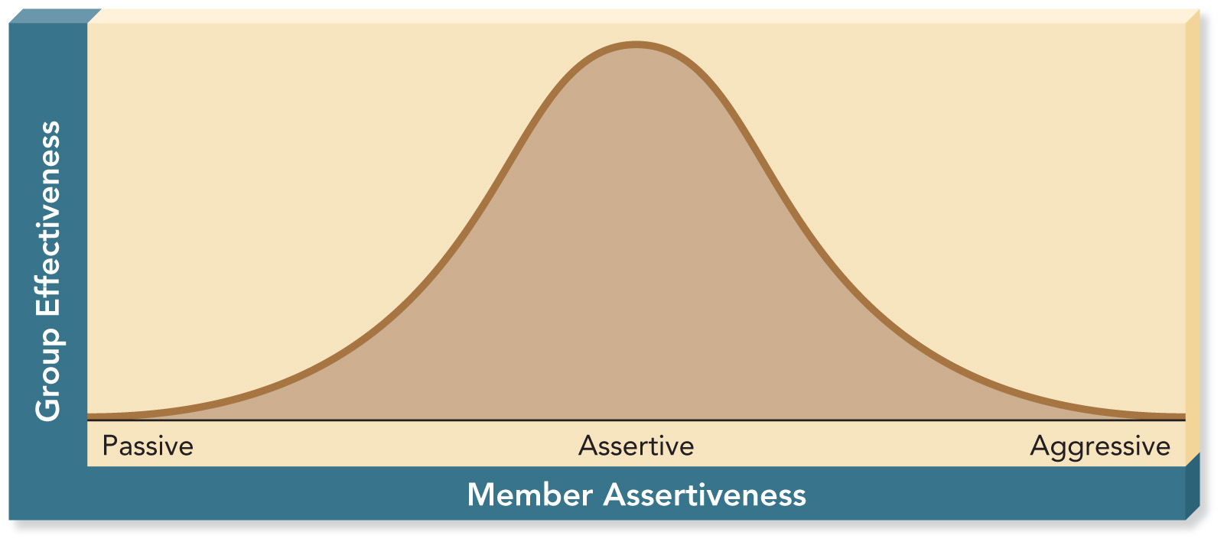
Group Effectiveness and Member Assertiveness

Slide 45
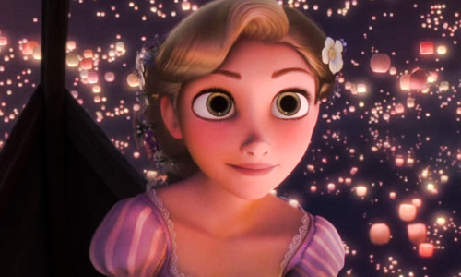

Group Effectiveness and Member Assertiveness

Slide 46
C
B
D
A
E

Slide 47
Aggressive
Assertive
Passive
Assertive
Assertive

Slide 48
Page 72
Achievement
Interaction-communication
Inclusion-do the job
Control
Affection

Slide 49
1. What need is most important in your study field? Why? 2. How do you predict your need will change in the next year?
 | Bean | nguyên | Vũ | Văn | Huy
Achievement | 10 | 11 | 12 | 14 | 10
Interaction | 8 |  | 10 | 9 | 8
Inclusion | 11 | 12 | 12 | 11 | 12
Control | 10 | 6 | 10 | 8 | 9
Affection | 12 | 0.1 | 11 | 12 | 8

Slide 50
 |  | Thoa | Thy | Linh | Vy | Tú Anh
achievement |  | 12 | 11 | 14 | 12 | 10++
interaction |  | 10 | 12 | 11 | 8 | 10++
inclusion |  | 9 | 12 | 10 | 9 | 14
control |  | 10 | 8 | 10 | 9 | 6
affection |  | 11 | 11 | 12 | 9 | 11

Slide 51
Assertiveness Skills in Groups
Devote time to preparing for meetings.
Ask a colleague to help you get a chance to speak.
Express your opinions clearly.
…..
.....
......
......

Slide 52
Assertiveness Skills in Groups
Devote time to preparing for meetings.
Ask a colleague to help you get a chance to speak.
Express your opinions clearly.
Maintain direct eye contact.
Assume an assertive body posture.
Express your feelings as well as thoughts.
Speak expressively (volume, pitch, rate).

Slide 53
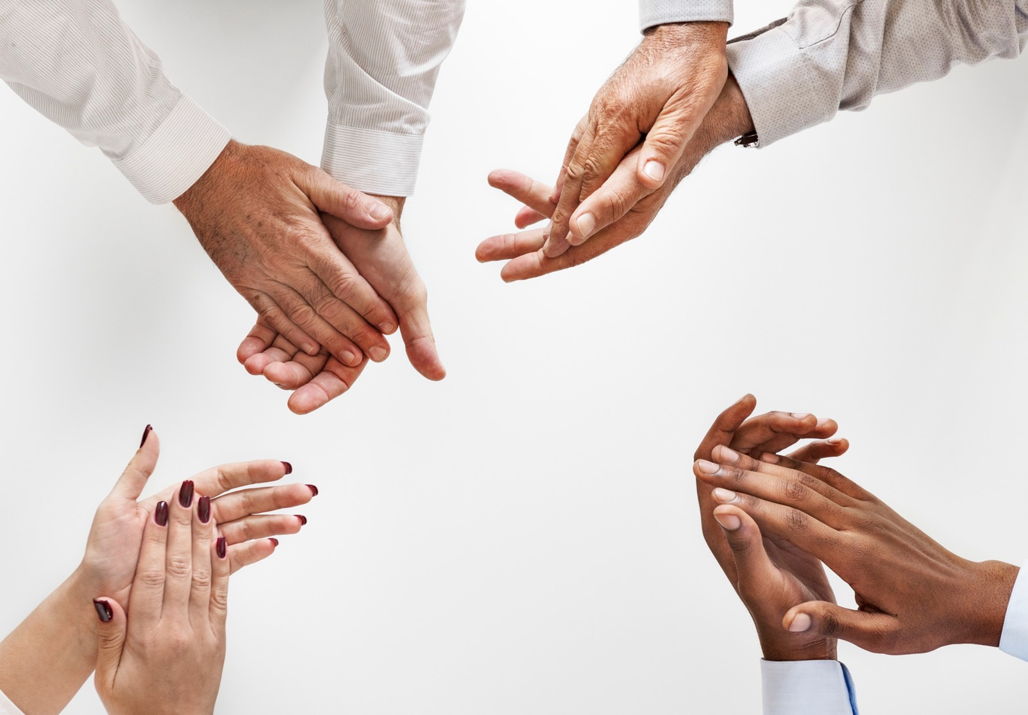




Thank You
Hoang Huy, MA.
+0964703668
huyhd11@fe.edu.vn
FPT University

